Slide 1
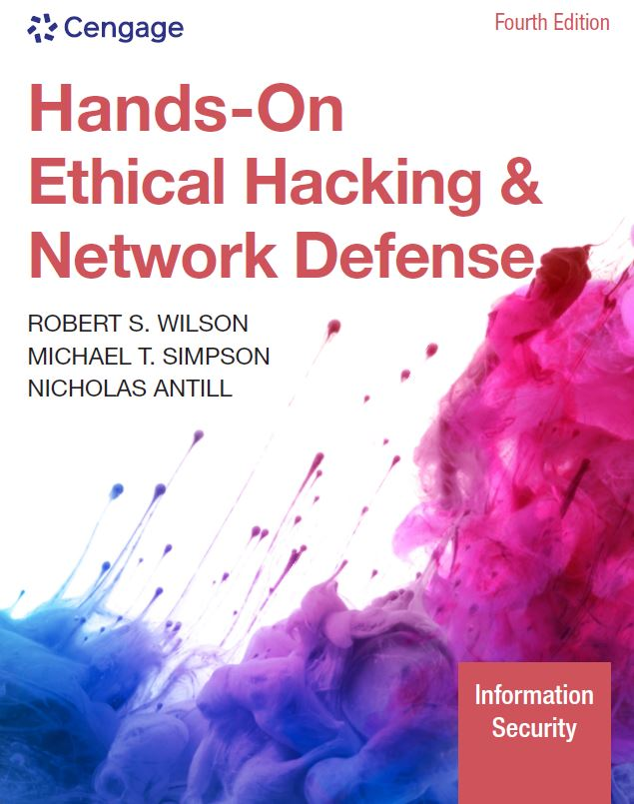
Hands-On Ethical Hacking and Network Defense, Edition 4
Module 8: Desktop and Server OS Vulnerabilities
Simpson, Antill, Wilson, Hands-On Ethical Hacking and Network Defense, 4th Edition. © 2023 Cengage. All Rights Reserved. May not be scanned, copied or duplicated, or posted to a publicly accessible website, in whole or in part.

Slide 2
Module Objectives
By the end of this module, you should be able to:
Describe vulnerabilities of the Windows and Linux operating systems
Identify specific vulnerabilities and explain ways to fix them
Explain techniques to harden Windows and Linux systems

Slide 3
Windows OS Vulnerabilities (1 of 2)
Many Windows OSs have serious vulnerabilities
Windows 2000 and earlier
Administrators had to disable, reconfigure, or uninstall services and features
Later versions of Windows
Disabled most services and features by default to improve security
To find vulnerabilities for any OS, you can check the CVE and CERT vulnerabilities websites

Slide 4
Windows Server Vulnerabilities Found at CVE
CVE ID | Description
CVE-2021-34527 | Windows 10, Server 2019, Server 2016, Server 2012, Server 2008, Windows 8.1, and Windows 7 have a flaw in the Printer Spooler subsystem that can allow attackers to remotely execute code. This flaw is so severe that Microsoft issued fixes for operating systems that are no longer officially supported (such as Windows 7).
CVE-2021-33740 | Windows 10, Server 2019, and Server 2016 have a flaw in the Windows Media subsystem that could allow an attacker to remotely execute code on the vulnerable system.
CVE-2021-33773 | Windows 10, Server 2019, Server 2016, Server 2012, and Windows 8.1 have a flaw by which users with remote access connections could elevate their permissions to give them administrative access.
CVE-2021-33756 | Windows 10, Server 2019, Server 2016, Server 2012, Server 2008, Windows 8.1, and Windows 7 have a flaw whereby the Windows DNS Snap-in can be exploited to allow Remote Code Execution.

Slide 5
Windows OS Vulnerabilities (2 of 2)
Many explanations on the CVE website are complex
Important that you’re able to research a vulnerability relevant to the security test you’re conducting
Security testers can use information from the CVE site to test a Windows computer
Make sure it’s been patched with updates from Microsoft that address known vulnerabilities

Slide 6
Windows File Systems
Purpose of any file system
Stores and manages information that users create
Organized OS files needed to boot the system
File system is the most vital part of any OS
Can be a vulnerability in some cases

Slide 7
File Allocation Table
Original Microsoft file system
Supported by nearly all desktop and server OSs from 1981 to now
Later versions provide for larger file and disk sizes
F A T32
The standard file system for most removable media other than CDs and DVDs
Most serious shortcoming
Doesn’t support file-level access control lists (ACLs)
ACLs are necessary for setting permissions on files
Multiuser environment results in a critical vulnerability

Slide 8
NTFS
New Technology File System (NTFS)
First released as a high-end file system in Windows NT 3.1 and in Windows NT 3.51
Added support for larger files, disk volumes, and ACL file security
Subsequent Windows versions
Included several upgrades
Some inherent vulnerabilities
Alternate data streams (ADSs)
Can “stream” (hide) information behind existing files
Without affecting their function, size, or other information
Makes it possible for system intruders to hide exploitation tools and other malicious files
Several detection methods exist

Slide 9
Remote Procedure Call
An interprocess communication mechanism
Allows a program running on one host to run code on a remote host
The Conficker worm exploited RPC by taking an advantage of a vulnerability in RPC
Ran arbitrary code on susceptible hosts
Nessus
Excellent tool for determining whether a system is vulnerable due to an RPC-related issue and for many other configuration and patching items as well

Slide 10
NetBIOS (1 of 2)
Software loaded into memory
Enables computer program to interact with network resource or device
NetBIOS isn’t a protocol
It is an interface to a network protocol that enables a program to access a network resource
NetBios Extended User Interface (NetBEUI)
Fast, efficient network protocol
Requires little configuration
Allows NetBIOS packets to be transmitted over TCP/IP and various topologies
NetBIOS over TCP/IP is disabled by default on current versions of Windows

Slide 11
NetBIOS (2 of 2)
Systems running newer Windows OSs can share files and resources without using NetBIOS
NetBIOS is still used for backward compatibility
Important when organizational budgets don’t allow upgrading
Customer expectations must be met

Slide 12
Server Message Block (1 of 2)
Used to share files
Usually runs on top of:
NetBIOS
NetBEUI
TCP/IP
Several hacking tools target SMB
Well-known tools are L0phtcrack’s SMB Packet Capture utility and SMBRelay
It took Microsoft seven years to patch the vulnerability that these tools exploited

Slide 13
Server Message Block (2 of 2)
Microsoft introduced SMB2 in Windows Vista, SMB3 in Windows 8, and SMB3.1.1 in Windows 10
Fixed security issues
Added several new features
SMB vulnerabilities are a common attack vector exploited by malware

Slide 14
Common Internet File System (1 of 3)
Common Internet File System (CIFS)
A standardized protocol that replaced SMB for Windows 2000 Server
SMB is still used for backward compatibility
CIFS is a remote file system protocol
Enables sharing of network resources over the Internet
Relies on other protocols to handle service announcements
Notifies users of available resources

Slide 15
Common Internet File System (2 of 3)
Offers many enhancements
Locking features
Caching and read-ahead/write-behind capability
Support for fault tolerance
Capability to run more efficiently over slow dial-up lines
Support for anonymous and authenticated access
Two methods for server security
Share-level security
User-level security

Slide 16
Common Internet File System (3 of 3)
Newer versions of Windows Server listen on most of the same ports as older versions
Most attackers look for servers designated as domain controllers
Servers that handle authentication
Windows domain controllers are usually global catalog servers
Global catalog servers are used to locate resources in a domain containing thousands or even millions of objects

Slide 17
Null Sessions
A null session is an anonymous connection established without credentials
Used to display information about users, groups, shares, and password policies
Necessary only if networks need to support older Windows versions
To enumerate NetBIOS vulnerabilities:
Use Nbtstat, Net view, Netstat, Ping, Pathping, and Telnet commands

Slide 18
Web Services
Older versions of Web services and IIS would install with critical security vulnerabilities
Microsoft developed the IIS Lockdown Wizard
Locks down IIS versions 4.0 and 5.0
IIS 5.0
Installed by default in Windows 2000 Server
A Windows 2000 server is also a web server using the default configuration, a setup many administrators aren’t aware of until a problem occurs
IIS 6.0 through IIS 10.0
Installs with a “secure by default” mode
Previous versions left crucial security holes
Keeping a system patched is important
Configuring only needed services and applications is a wise move

Slide 19
MS SQL Server
Older versions of SQL Server have many potential vulnerabilities
Null System Administrator (SA) password
Most common critical SQL vulnerability
Allows remote users to gain System Administrator (SA) access through the SA account on the server
May occur in all versions before SQL Server 2005
SQL Server 2000
An SA account with a blank password is created, and this account can’t be disabled
Gives attackers administrative access to the database and the database server

Slide 20
Buffer Overflows
Data is written to a buffer and corrupts data in memory next to allocated buffer
Normally, this problem occurs when dangerous functions use input that has not been properly validated
Because of design flaws, functions don’t verify text fits
Attackers can run shell code
C and C++
Lack built-in protection against overwriting data in memory

Slide 21
Passwords and Authentication (1 of 3)
Authorized users are the weakest security link in any network
Most difficult to secure
Relies on people who might not realize that their actions could expose their organization to a major security breach
Companies should take steps to address this vulnerability
A comprehensive password policy is critical

Slide 22
Passwords and Authentication (2 of 3)
A comprehensive password policy should include the following:
Change passwords regularly (quarterly)
Require at least eight characters
Require complex passwords
Passwords can’t be common words, dictionary words, slang, jargon, or dialect
Passwords must not be identified with a particular user
Never write it down or store it online or in a file
Do not reveal it to anyone
Use caution when logging on and limit reuse

Slide 23
Passwords and Authentication (3 of 3)
Configure domain controllers to enforce password age, length, and complexity
Password policy aspects that can be enforced:
Account lockout threshold
Set the number of failed attempts before an account is disabled temporarily
Account lockout duration
Set the period of time an account is locked out after failed logon attempts
Windows Server 2008 and newer domain controllers
Multiple password policies can be enforced

Slide 24
Knowledge Check Activity 8-1
Windows OSs are vulnerable to the Conficker worm because of which of the following?
Arbitrary code
SQL buffer overflow
Blank password
RPC vulnerability
Notes:
Instructions:
Use the Knowledge Check questions to periodically pose a question to students during class to gauge how well they can recall the material that was presented.

Slide 25
Knowledge Check Activity 8-1: Answer
Windows OSs are vulnerable to the Conficker worm because of which of the following?
Answer: d. RPC vulnerability
Remote Procedure Call (RPC) is an interprocess communication mechanism that allows a program running on one host to run code on a remote host. Windows OSs are vulnerable as the Conficker worm takes advantage of a vulnerability in RPC to run arbitrary code on susceptible hosts.

Slide 26
Polling Activity 8-1
Which of the following is a well-known SMB hacking tool? (Choose all that apply.)
SMBRelay
SMBsnag
L0phtcrack’s SMB Packet Capture utility
NTPass
Notes:
Instructions:
1. Use this activity to solicit student opinions about ethical hacking and related concepts in the module or to play a game.
2. Go to kahoot.com, or the platform of your preference, and log in or sign up.
3. Create the challenge.
4. Teacher Tip: Turn off the timer to prioritize accuracy or turn on the nickname generator to avoid inappropriate nicknames.
5. Invite players by sharing the link or PIN.
6. This can be done synchronously during class or asynchronously for review or homework.

Slide 27
Polling Activity 8-1: Answer
Which of the following is a well-known SMB hacking tool?
Answer: a. and c. SMBRelay and L0phtcrack’s SMB Packet Capture utility
The two well-known SMB hacking tools are L0phtcrack’s SMB Packet Capture utility and SMBRelay, which intercept SMB traffic and collect usernames and password hashes.

Slide 28
Polling Activity 8-2
Applications written in which programming language are especially vulnerable to buffer overflow attacks? (Choose all that apply.)
C
Perl
C++
Java
Notes:
Instructions:
1. Use this activity to solicit student opinions about ethical hacking and related concepts in the module or to play a game.
2. Go to kahoot.com, or the platform of your preference, and log in or sign up.
3. Create the challenge.
4. Teacher Tip: Turn off the timer to prioritize accuracy or turn on the nickname generator to avoid inappropriate nicknames.
5. Invite players by sharing the link or PIN.
6. This can be done synchronously during class or asynchronously for review or homework.

Slide 29
Polling Activity 8-2: Answer
Applications written in which programming language are especially vulnerable to buffer overflow attacks?
Answer: a. and c. C and C+ +
Both C and C++ lack built-in protection against overwriting data in memory, so applications written in these languages are vulnerable to buffer overflow attacks.

Slide 30
Tools for Identifying Vulnerabilities in Windows
Many tools are available
Using more than one is advisable
Using several tools helps pinpoint problems more accurately
Some popular OS vulnerability scanners:
Tripwire IP360, Tenable Nessus, Nexpose, and OpenVAS

Slide 31
Scanning Windows Using Nessus Essentials
Many security attacks can be avoided with careful system analysis and maintenance
When Microsoft learns of problems or vulnerabilities in its software, it publishes:
Patches
Security updates
Service packs
Hotfixes

Slide 32
Common Windows Server Configuration and Security Issues (1 of 4)
Type of issue | Details to check for
Security updates missing | Missing Windows, IIS, and SQL Server security updates Missing Exchange Server security updates Missing IE security updates Missing Windows Media Player and Office security updates Missing Microsoft Virtual Machine (VM) and Microsoft Data Access Components (MDAC) security updates Missing MSXML and Content Management Server security updates
Windows configuration | Account password expirations left at default settings, not matching company policy (30 days, etc.). This should be changed to match company policy. Blank or simple passwords are used for local user accounts. This should be changed to match company password policy. File system type on hard drives is insecure. F A T being used when NTFS should be used to provide ACLs. Change to NTFS if possible. Auto Logon feature is enabled. Disable if this feature is not required.

Slide 33
Common Windows Server Configuration and Security Issues (2 of 4)
Type of issue | Details to check for
Windows configuration | Number of local Administrator accounts should be 1 or 2 at most. Is the Guest account enabled? Disable this account if it is not required. Restrict Anonymous Registry key setting should be set to not allow anonymous access if not a business requirement. List shares on the computer and any unnecessary services running. Make sure shares are credential secured and stop unnecessary services. Windows version and whether Windows auditing is enabled. Is the Windows version supported by updates? Auditing creates log entries to track file access. Is this set to meet company policy? Firewall status and Automatic Updates status. Is the firewall enabled and configured to match company policy or left at defaults? Are automatic updates configured to match company policy?
IIS (Internet Information Service) | Is the IIS Lockdown tool running? If the server version is older than 2003, IIS Lockdown needs to be running. Are IIS sample applications and the IIS Admin virtual folder installed? These are default installation items and should be removed or secured. Are IIS parent paths enabled? If enabled, this default setting may need to be evaluated or disabled.

Slide 34
Common Windows Server Configuration and Security Issues (3 of 4)
Type of issue | Details to check for
IIS (Internet Information Service) | MSADC and Scripts virtual directories are installed by default and should be removed or disabled. IIS logging should be enabled. IIS should not be running on a domain controller. Does the Administrators group belong in the Sysadmin role? This setting may be a default configuration. If not intended, remove the Administrators group. Make sure the CmdExec role is restricted to Sysadmin only. SQL Server should not be running on a domain controller. The SA account password should not be default or blank, and the Guest account should not have database access. Access permissions to SQL Server installation folders should not be left at default settings. The Everyone group should not have access to SQL Server Registry keys. SQL Server service accounts should not be members of the local Administrators group. If compromised, hackers will have admin access. SQL Server accounts should not have blank or simple passwords.

Slide 35
Common Windows Server Configuration and Security Issues (4 of 4)
Type of issue | Details to check for
SQL configuration | Check SQL Server authentication mode type to make sure it matches security requirements. The number of Sysadmin role members should be at the minimum.
Desktop application configuration | IE security zone settings for each local user should match company policy. Is IE Enhanced Security Configuration enabled for Administrator accounts and is it configured to be secure? Administrator accounts should avoid browsing the Internet, and sessions need to be highly secured. Is IE Enhanced Security Configuration enabled for non-Administrator accounts? This setting must be configured to match company policy and not accidentally left at default settings. What are the Microsoft Office security zone settings for each local user? These should be set to match company policy and not accidentally left at default settings.

Slide 36
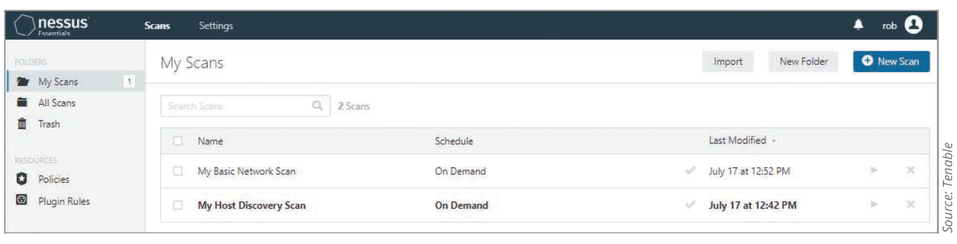
Using Nessus Essentials
If you have access to a Windows server that you have permission to scan, then use that as your target to see what vulnerabilities Nessus Essentials might discover

Slide 37
Best Practices for Hardening Windows Systems
Penetration tester finds and reports vulnerabilities as defined in their contract
Security tester:
Finds vulnerabilities
Gives recommendations for correcting vulnerabilities

Slide 38
Patching Systems (1 of 2)
Best way to keep systems secure
Keep them up to date
Attackers take advantage of known vulnerabilities that has a patch available
Options for few computers (10 or fewer)
Accessing Windows Update manually
Time-consuming
Configure Automatic Updates on each machine depending on the Windows version
Options for large networks
Systems Management Server (SMS)
From 1994 to 2005, SMS was the standard for managing Windows security patches
Assessed machines in a defined domain and could be configured to manage patch deployment

Slide 39
Patching Systems (2 of 2)
Windows Software Update Service (WSUS)
Downloads patches and publishes them internally to servers and desktop systems
The administrator has control over which updates are deployed
Windows System Center Configuration Manager (SCCM)
Includes a suite of tools to help administrators deploy and manage servers alongside updated patch-management functionality
Third-party patch-management solutions
BigFix, Tanium, and BladeLogic

Slide 40
Antivirus Solutions
Antivirus solution is essential for:
Small networks
Desktop antivirus tools with automatic updates might be enough
Large networks
Require corporate-level solution
Antivirus tools
Must be planned, installed, and configured correctly to ensure the best protection
Almost useless if not updated regularly

Slide 41
Enable Logging and Review Logs Regularly
Logging is a crucial function for monitoring system security
Carefully record only useful statistics
Review logs regularly for signs of intrusion or other problems
Use log-monitoring tool
Build prevention and detection by considering what attackers might do if they compromised your network
Commands like ipconfig /all, netstat -r, net view, and gpresult, especially when grouped together, could be seen as suspicious

Slide 42
Disable Unused Services and Filtering Ports
Disable unneeded services
Delete unnecessary applications or scripts
Unused applications are invitations for attacks
Reducing the attack surface
Open only what needs to be open, and close everything else
Filter out unnecessary ports
Make sure perimeter routers filter out ports 137 to 139 and 445
Protects against external null session attacks

Slide 43
Other Security Best Practices (1 of 2)
Other practices include the following:
Minimize the number of administrative users
Implement software preventing data from leaving
Use network segmentation
Restrict the number of applications allowed to execute on a computer connected to the network
Delete unused scripts and sample applications
Delete default hidden shares
Use unique naming scheme and passwords
Ensure password length/complexity are sufficient

Slide 44
Other Security Best Practices (2 of 2)
Other practices include the following (continued):
Be careful of default permissions
Use appropriate packet-filtering techniques
Use open-source or commercial tools to assess system security
Use a file-integrity checker
Disable the Guest account
Disable the local Administrator account
Disable accounts of users no longer with the company
Make sure there are no accounts with blank passwords
Use Windows group policies to enforce security configurations on large networks efficiently and consistently
Develop a comprehensive security awareness program
Keep up with emerging threats

Slide 45
Linux OS Vulnerabilities
Linux can be made more secure if users are:
Aware of its vulnerabilities
Keep current on new releases and fixes
Many versions are available
Differences range from slight to major
It’s important to understand basics
Run control and service configuration
Directory structure and file system
Basic shell commands and scripting
Package management

Slide 46
Samba
Created as an open-source implementation of CIFS in 1992
To address the issue of interoperability
Allows *nix servers to share resources with Windows clients
Security professionals should have a basic knowledge of SMB and Samba because many companies have a mixed environment of Windows and *nix systems
Often used on networks that require *nix computers to access Windows resources
Designed to “trick” Windows services into believing *nix resources are Windows resources
*nix clients can connect to Windows shared printer and vice versa when Samba is configured on the *nix computer

Slide 47
Tools for Identifying Linux Vulnerabilities (1 of 5)
CVE website
Source for discovering possible attacker avenues
CVE/CAN | Description
CVE-2021-36148 | A buffer overflow in the function dmar_free_irte in the file hypervisor/arch/x86/vtd.c allows the attacker to corrupt memory.
CVE-2021-35039 | A vulnerability was found in Linux Kernel up to 5.12.13 affecting the function init_module of the file kernel/module.c. The manipulation with an unknown input leads to a weak authentication vulnerability.
CVE-2019-14896 | A heap-based buffer overflow vulnerability was found in the Linux kernel, version kernel-2.6.32, in Marvell WiFi chip driver. A remote attacker could cause a denial of service (system crash) or possibly execute arbitrary code when the lbs_ibss_join_existing function is called after a STA connects to an AP.

Slide 48
Tools for Identifying Linux Vulnerabilities (2 of 5)
CVE information can be used for testing Linux computers for known vulnerabilities
OpenVAS can enumerate multiple OSs
Security tester using enumeration tools can:
Identify a computer on the network by using port scanning and zone transfers
Identify the OS by conducting port scanning and enumeration
Identify via enumeration any logon accounts and passwords
Learn names of shared folders by using enumeration
Identify services running on the computer

Slide 49
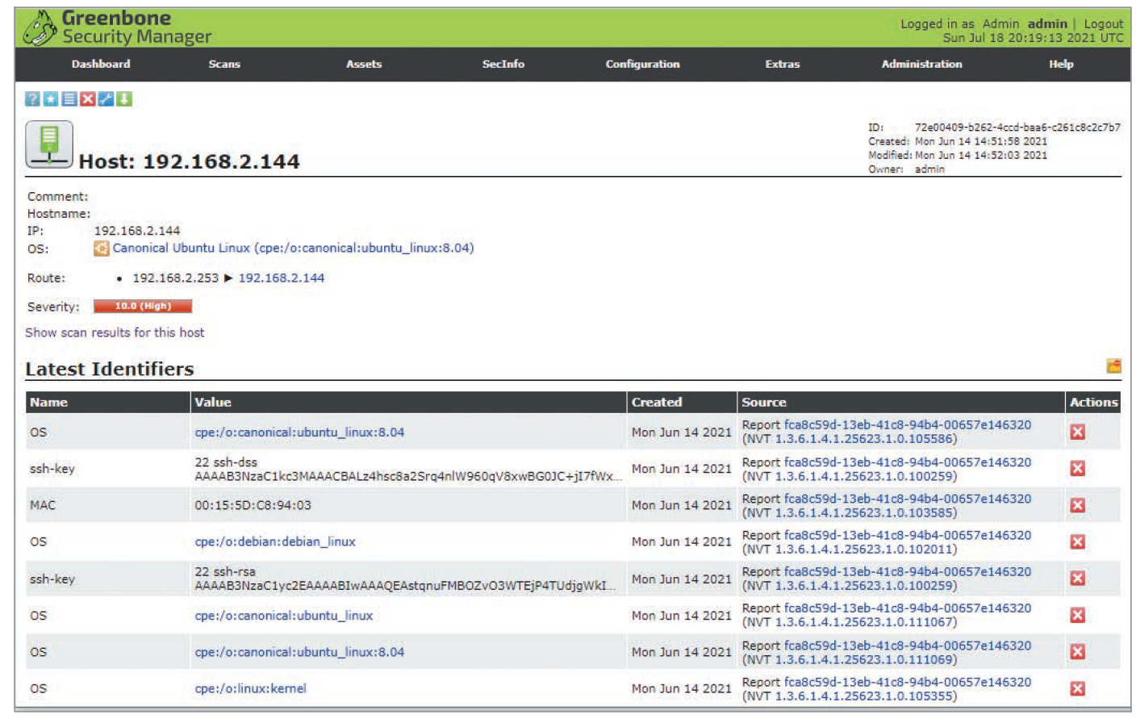
Tools for Identifying Linux Vulnerabilities (3 of 5)
Source: GNU General Public License
Figure 8-6 OpenVAS has determined the target system is running Ubuntu Linux

Slide 50
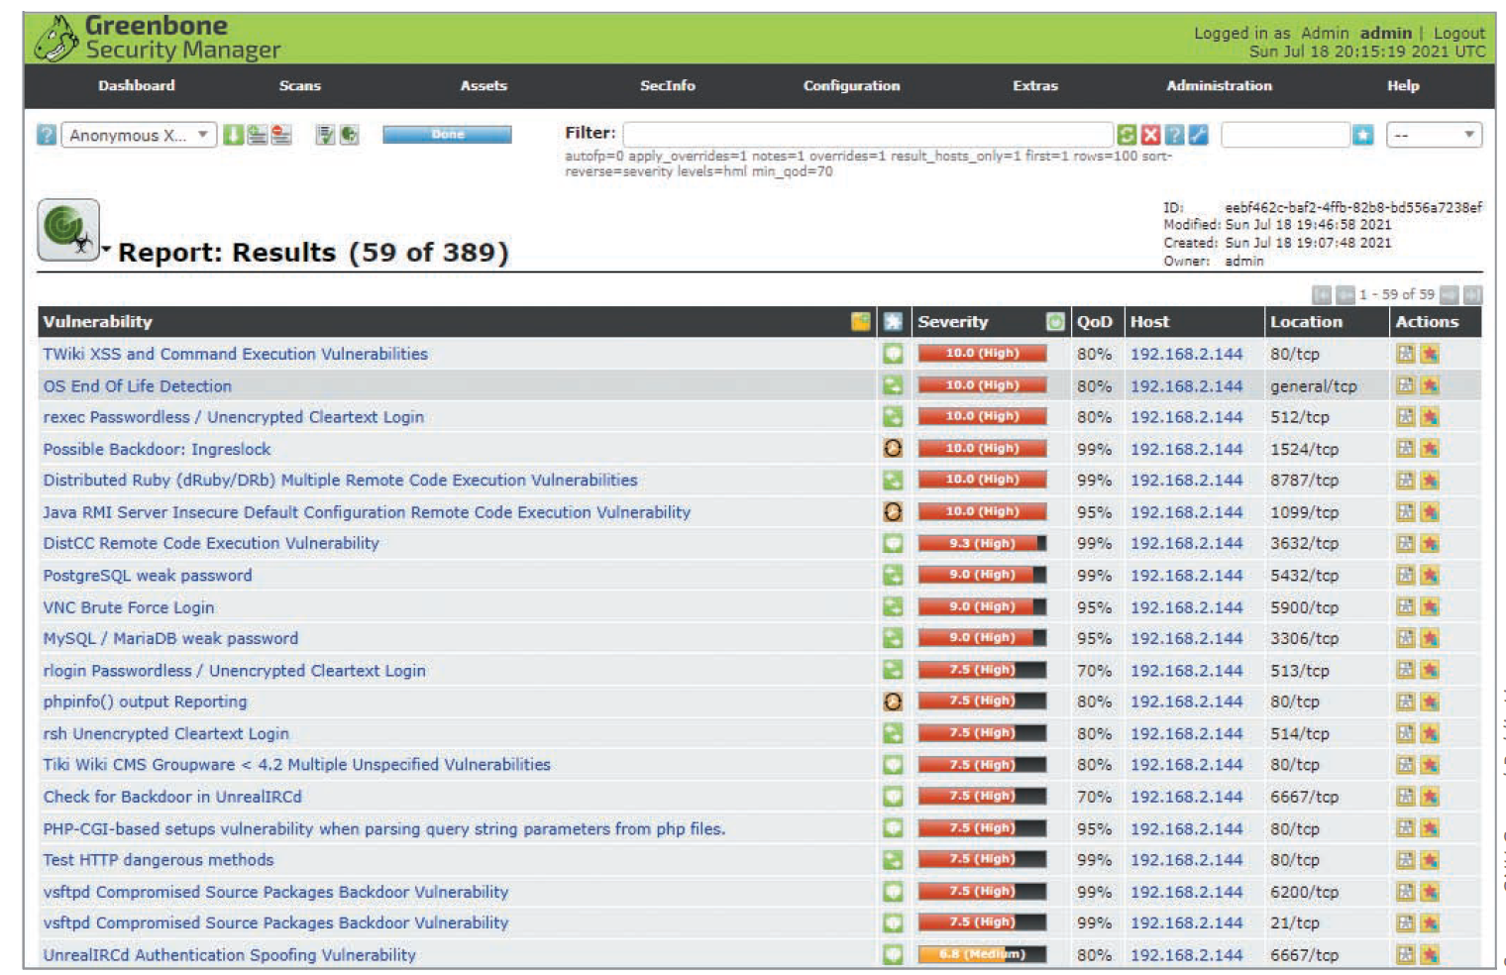
Tools for Identifying Linux Vulnerabilities (4 of 5)
Source: GNU General Public License
Figure 8-8 Report of OpenVAS scan of 192.168.2.144

Slide 51
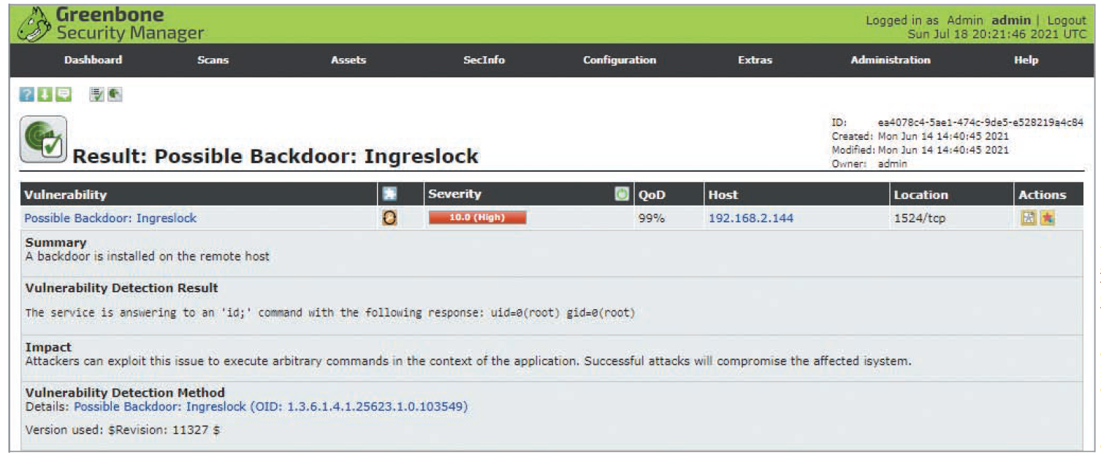
Tools for Identifying Linux Vulnerabilities (5 of 5)
Source: GNU General Public License
Figure 8-9 Possible Backdoor: Ingreslock vulnerability found

Slide 52
Checking for Trojans (1 of 2)
Trojan programs perform one or more of the following:
Allow remote administration of attacked system
Create a hidden file server on the attacked computer
Files can be uploaded and downloaded
Steal passwords from the attacked system
Email them to attacker
Log all keystrokes a user enters
Email the results or store them in a hidden file that the attacker can access remotely

Slide 53
Checking for Trojans (2 of 2)
Linux Trojan programs
Sometimes disguised as legitimate programs
Contain program code that can wipe out file systems
More difficult to detect today
Protecting Linux computers against identified Trojan programs is easier
Rootkits containing Trojan binary programs
More dangerous
Attackers hide tools
Perform further attacks
Have access to backdoor programs

Slide 54
More Countermeasures against Linux Attacks
Most critical tasks:
Training users
Keeping up on kernel releases and security updates
Configuring systems to improve security

Slide 55
User Awareness Training
Make it difficult for social engineers to get information from employees
Include all employees in the training
No information should be given to outsiders
Knowing the OS that the company is running makes attacks easier to select an exploit
Teach users to be suspicious of people asking questions about the systems they are using
Verify whom they are talking to
Ask for a phone number to call them back

Slide 56
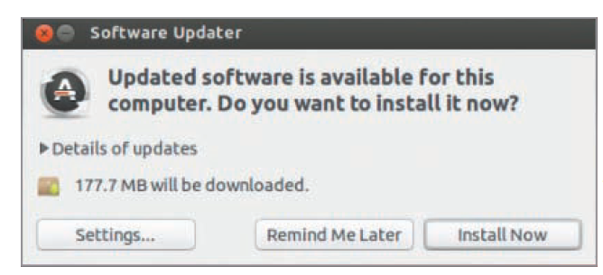
Keeping Current
As soon as a vulnerability is discovered and posted, OS vendors notify customers of upgrades and patches
Installing fixes promptly is essential to protect your system
Linux distributions
Most display warnings to inform users when they are running outdated versions
Source: Ubuntu

Slide 57
Secure Configuration
Many methods and tools can be used to configure a Linux system to help prevent intrusions
Vulnerability scanners
Built-in Linux tools
Security Enhanced Linux (SELinux)
Uses Mandatory Access Control (MAC), an OS security mechanism that enforces access rules based on privileges for interactions between processes, files, and users
Free benchmark PDFs and tools provided by the Center for Internet Security (CIS)
OS Lockdown
A commercial tool (formerly known as Security Blanket)
Used to secure system quickly and save *nix system administrators from hours of manual configuration work

Slide 58
Knowledge Check Activity 8-2
For a Windows computer to be able to access a *nix resource, CIFS must be enabled on at least one of the systems. True or false?
True
False
Notes:
Instructions:
Use the Knowledge Check questions to periodically pose a question to students during class to gauge how well they can recall the material that was presented.

Slide 59
Knowledge Check Activity 8-2: Answer
For a Windows computer to be able to access a *nix resource, CIFS must be enabled on at least one of the systems. True or false?
Answer: False.
To access a *nix resource from a Windows computer, CIFS must be enabled on both systems.

Slide 60
Discussion Activity 8-1
Discuss the measures that you can take for protecting systems on any network. Make a list of these measures and compare your answers with that of your classmates.
Notes:
Instructions:
Use the Discussion activity to encourage group conversation about a related topic of interest.

Slide 61
Discussion Activity 8-1: Answer
Discuss the measures that you can take for protecting systems on any network.
Answer: The measures for protecting systems on any network include having user awareness training programs, running antivirus tools, disabling unneeded services, filtering out unnecessary ports, installing security updates and patches, securing configurations, application whitelisting, and reviewing logs.

Slide 62
Self-Assessment
Recall the methods for improving security on tested systems.
Describe how the risks posed by vulnerabilities on embedded operating systems can be minimized.
Notes:
Instructions:
Use the Self-Assessment question to encourage students to evaluate their progress or goals in the course, as well as determine how they might apply their learning or grow as an individual.

Slide 63
Summary
Now that the lesson has ended, you should be able to:
Describe vulnerabilities of the Windows and Linux operating systems
Identify specific vulnerabilities and explain ways to fix them
Explain techniques to harden Windows and Linux systems

